Slide 1

Algorithms
ROBERT SEDGEWICK | KEVIN WAYNE
Symbol table implementations: summary
implementation | guarantee |  |  | average case |  |  | ordered ops? | key interface
 | search | insert | delete | search hit | insert | delete
sequential search (unordered list) | N | N | N | ½ N | N | ½ N |  | equals()
binary search (ordered array) | lg N | N | N | lg N | ½ N | ½ N | ✔ | compareTo()
BST | N | N | N | 1.39 lg N | 1.39 lg N | √ N | ✔ | compareTo()
red-black BST | 2 lg N | 2 lg N | 2 lg N | 1.0 lg N | 1.0 lg N | 1.0 lg N | ✔ | compareTo()
3.4 HASH TABLES
hash functions
separate chaining
linear probing
context
Algorithms
F O U R T H E D I T I O N
ROBERT SEDGEWICK | KEVIN WAYNE
http://algs4.cs.princeton.edu
Q. Can we do better?
A. Yes, but with different access to the data.
2
Hashing: basic plan
Save items in a key-indexed table (index is a function of the key).
Hash function. Method for computing array index from key.
0
1
"it"
hash("it") = 3
2
3
3.4 HASH TABLES
Issues.
??
4
5
hash functions
separate chaining
linear probing
context
・Computing the hash function.
hash("times") = 3
・Equality test: Method for checking whether two keys are equal.
・Collision resolution: Algorithm and data structure
to handle two keys that hash to the same array index.
Algorithms
Classic space-time tradeoff.
ROBERT SEDGEWICK | KEVIN WAYNE
・No space limitation: trivial hash function with key as index.
・No time limitation: trivial collision resolution with sequential search.
・Space and time limitations: hashing (the real world).
http://algs4.cs.princeton.edu
3

Slide 2

Computing the hash function
Java’s hash code conventions
Idealistic goal. Scramble the keys uniformly to produce a table index.
All Java classes inherit a method hashCode(), which returns a 32-bit int.
・Efficiently computable.
・Each table index equally likely for each key.
thoroughly researched problem,
still problematic in practical applications
key
Requirement. If x.equals(y), then (x.hashCode() == y.hashCode()). Highly desirable. If !x.equals(y), then (x.hashCode() != y.hashCode()).
Ex 1. Phone numbers.
y
・Bad: first three digits.
x
・Better: last three digits.
table index
Ex 2. Social Security numbers.
x.hashCode()
y.hashCode()
・Bad: first three digits.
573 = California, 574 = Alaska
(assigned in chronological order within geographic region)
・Better: last three digits.
Default implementation. Memory address of x. Legal (but poor) implementation. Always return 17.
Customized implementations. Integer, Double, String, File, URL, Date, … User-defined types. Users are on their own.
Practical challenge.
Need different approach for each key type.
5
6
Implementing hash code: integers, booleans, and doubles
Java library implementations
public final class Double
{
private final double value;
...
public int hashCode()
{
long bits = doubleToLongBits(value); return (int) (bits ^ (bits >>> 32));
}
}
convert to IEEE 64-bit representation; xor most significant 32-bits
with least significant 32-bits
Warning: -0.0 and +0.0 have different hash codes
7
Implementing hash code: strings
Java library implementation
public final class Integer
{
private final int value;
...
}
public final class String
{
private final char[] s;
...
public int hashCode()
{
int hash = 0;
for (int i = 0; i < length(); i++) hash = s[i] + (31 * hash);
return hash;
} i^{th} character of s
}
char | Unicode
… | …
'a' | 97
'b' | 98
'c' | 99
… | ...
public int hashCode()
{ return value; }
public final class Boolean
{
private final boolean value;
...
}
・Horner's method to hash string of length L:
L multiplies/adds.
public int hashCode()
{
if (value) return 1231; else return 1237;
}
・Equivalent to h = s[0] · 31^{L–1} + … + s[L – 3] · 31² + s[L – 2] · 31¹ + s[L – 1] · 31⁰.
Ex.
String s = "call";
int code = s.hashCode();
3045982 = 99·31³ + 97·31² + 108·31¹ + 108·31⁰
= 108 + 31· (108 + 31 · (97 + 31 · (99)))
(Horner's method)
8

Slide 3



Implementing hash code: strings
Implementing hash code: user-defined types
Performance optimization.
・Cache the hash value in an instance variable.
public final class Transaction implements Comparable<Transaction>
{
private final String who; private final Date when; private final double amount;
public Transaction(String who, Date when, double amount)
{ /* as before */ }
...
public boolean equals(Object y)
{ /* as before */ }
・Return cached value.
public final class String
{
private int hash = 0;
cache of hash code
private final char[] s;
...
public int hashCode()
{
int h = hash;
if (h != 0) return h;
return cached value
public int hashCode()
{
int hash = 17;
for (int i = 0; i < length(); i++) h = s[i] + (31 * h);
nonzero constant
for reference types, use hashCode()
hash = h;
store cache of hash code
hash = 31*hash + who.hashCode(); hash = 31*hash + when.hashCode();
hash = 31*hash + ((Double) amount).hashCode(); return hash;
}
return h;
for primitive types, use hashCode() of wrapper type
}
}
Q. What if hashCode() of string is 0?
}
typically a small prime
9
10
Hash code design
Modular hashing
Hash code. An int between -2³¹ and 2³¹ - 1.
Hash function. An int between 0 and M - 1 (for use as array index).
typically a prime or power of 2
x
bug
x.hashCode()
1-in-a-billion bug
hash(x)
hashCode() of "polygenelubricants" is -2³¹
correct
"Standard" recipe for user-defined types.
・Combine each significant field using the 31x + y rule.
・If field is a primitive type, use wrapper type hashCode().
・If field is null, return 0.
・If field is a reference type, use hashCode().
applies rule recursively
or use Arrays.deepHashCode()
private int hash(Key key)
{ return key.hashCode() % M; }
・If field is an array, apply to each entry.
In practice. Recipe works reasonably well; used in Java libraries. In theory. Keys are bitstring; "universal" hash functions exist.
private int hash(Key key)
{ return Math.abs(key.hashCode()) % M; }
private int hash(Key key)
{ return (key.hashCode() & 0x7fffffff) % M; }
Basic rule. Need to use the whole key to compute hash code; consult an expert for state-of-the-art hash codes.
11
12

Slide 4

Uniform hashing assumption
Uniform hashing assumption
Uniform hashing assumption. Each key is equally likely to hash to an integer between 0 and M - 1.
Bins and balls. Throw balls uniformly at random into M bins.
0 1 2 3 4 5 6 7 8 9 10 11 12 13 14 15
Java's String data uniformly distribute the keys of Tale of Two Cities
14
Uniform hashing assumption. Each key is equally likely to hash to an integer between 0 and M - 1.
Bins and balls. Throw balls uniformly at random into M bins.
0 1 2 3 4 5 6 7 8 9 10 11 12 13 14 15
Birthday problem. Expect two balls in the same bin after ~
π M / 2 tosses.
Hash value frequencies for words in Tale of Two Cities (M = 97)
Coupon collector. Expect every bin has ≥ 1 ball after ~ M ln M tosses.
Load balancing. After M tosses, expect most loaded bin has
Θ ( log M / log log M ) balls.
13
Collisions
Collision. Two distinct keys hashing to same index.
・Birthday problem ⇒ can't avoid collisions unless you have a ridiculous (quadratic) amount of memory.
・Coupon collector + load balancing ⇒ collisions are evenly distributed.
3.4 HASH TABLES
hash functions
separate chaining
linear probing
context
0
1
"it"
Algorithms
hash("it") = 3
2
3
??
4
5
ROBERT SEDGEWICK | KEVIN WAYNE
hash("times") = 3
http://algs4.cs.princeton.edu
Challenge. Deal with collisions efficiently.
16

Slide 5

Separate-chaining symbol table
Separate-chaining symbol table: Java implementation
Use an array of M < N linked lists. [H. P. Luhn, IBM 1953]
public class SeparateChainingHashST<Key, Value>
{
private int M = 97; // number of chains private Node[] st = new Node[M]; // array of chains
・Hash: map key to integer i between 0 and M - 1.
・Insert: put at front of i^{th} chain (if not already there).
array doubling and halving code omitted
・Search: need to search only i^{th} chain.
key hash value
private static class Node
{
private Object key; private Object val; private Node next;
...
}
S 2 0
E 0 1
A 0 2
R 4 3
C 4 4
H 4 5
E 0 6
X 2 7
A 0 8
M 4 9
P 3 10
L 3 11
E 0 12
no generic array creation
(declare key and value of type Object)
A
8
E
12
0
1
2
3
4
st[]
null
private int hash(Key key)
{ return (key.hashCode() & 0x7fffffff) % M; }
X
7
S
0
public Value get(Key key) { int i = hash(key);
for (Node x = st[i]; x != null; x = x.next)
if (key.equals(x.key)) return (Value) x.val; return null;
}
L
11
P
10
M
9
H
5
C
4
R
3
}
17
18
Separate-chaining symbol table: Java implementation
Analysis of separate chaining
public class SeparateChainingHashST<Key, Value>
{
private int M = 97; // number of chains private Node[] st = new Node[M]; // array of chains
private static class Node
{
private Object key; private Object val; private Node next;
...
}
private int hash(Key key)
{ return (key.hashCode() & 0x7fffffff) % M; }
}
Proposition. Under uniform hashing assumption, prob. that the number of keys in a list is within a constant factor of N / M is extremely close to 1.
Pf sketch. Distribution of list size obeys a binomial distribution.
(10, .12511...)
.125
0
0
10 20 30
Binomial distribution (N = 10⁴ , M = 10³ , a = 10 )
public void put(Key key, Value val) { int i = hash(key);
for (Node x = st[i]; x != null; x = x.next)
if (key.equals(x.key)) { x.val = val; return; } st[i] = new Node(key, val, st[i]);
}
equals() and hashCode()
Consequence. Number of probes for search/insert is proportional to N / M.
・M too large
⇒ too many empty chains. chains too long.
M ~ N / 4 ⇒ constant-time ops.
・M too small ⇒
M times faster than sequential search
・Typical choice:
19
20

Slide 6







Resizing in a separate-chaining hash table
Deletion in a separate-chaining hash table
Goal. Average length of list N / M = constant.
Q. How to delete a key (and its associated value)?
A. Easy: need only consider chain containing key.
・Double size of array M when N / M ≥ 8.
・Halve size of array M when N / M ≤ 2.
・Need to rehash all keys when resizing.
x.hashCode() does not change but hash(x) can change
before deleting C
after deleting C
before resizing
st[]
0
A
B
C
D
E
F
G
H
I
J
st[]
K
I
st[]
K
I
1
K
L
M
N
O
P
0
P
N
L
0
P
N
L
1
1
2
J
F
C
B
2
J
F
B
after resizing
3 3
M M
st[]
K
I
O
O
0
P
N
L
E
A
1
2
J
F
C
B
3
O
M
H
G
D
21
22
Symbol table implementations: summary
implementation | guarantee |  |  | average case |  |  | ordered ops? | key interface
 | search | insert | delete | search hit | insert | delete
sequential search (unordered list) | N | N | N | ½ N | N | ½ N |  | equals()
binary search (ordered array) | lg N | N | N | lg N | ½ N | ½ N | ✔ | compareTo()
BST | N | N | N | 1.39 lg N | 1.39 lg N | √ N | ✔ | compareTo()
red-black BST | 2 lg N | 2 lg N | 2 lg N | 1.0 lg N | 1.0 lg N | 1.0 lg N | ✔ | compareTo()
separate chaining | N | N | N | 3-5 * | 3-5 * | 3-5 * |  | equals() hashCode()
3.4 HASH TABLES
hash functions
separate chaining
linear probing
context
Algorithms
ROBERT SEDGEWICK | KEVIN WAYNE
http://algs4.cs.princeton.edu
* under uniform hashing assumption
23

Slide 7




Collision resolution: open addressing
Linear-probing hash table demo
Open addressing. [Amdahl-Boehme-Rocherster-Samuel, IBM 1953] When a new key collides, find next empty slot, and put it there.
Hash. Map key to integer i between 0 and M-1.
Insert. Put at table index i if free; if not try i+1, i+2, etc.
st[0]
st[1]
st[2]
st[3]
st[30000]
jocularly
null
listen suburban
null
browsing
linear-probing hash table
0
1
2
3
4
5
6
7
8
9
10
11
12
13
14
15
st[]
M = 16
linear probing (M = 30001, N = 15000)
25
Linear-probing hash table demo
Linear-probing hash table summary
Hash. Map key to integer i between 0 and M-1.
Search. Search table index i; if occupied but no match, try i+1, i+2, etc.
Hash. Map key to integer i between 0 and M-1.
Insert. Put at table index i if free; if not try i+1, i+2, etc.
Search. Search table index i; if occupied but no match, try i+1, i+2, etc.
Note. Array size M must be greater than number of key-value pairs N.
search K hash(K) = 5
0
1
2
3
4
5
6
7
8
9
10
11
12
13
14
15
0
1
2
3
4
5
6
7
8
9
10
11
12
13
14
15
st[]
P | M |  |  | A | C | S | H | L |  | E |  |  |  | R | X
st[]
P | M |  |  | A | C | S | H | L |  | E |  |  |  | R | X
M = 16
K
search miss (return null)
M = 16
28

Slide 8


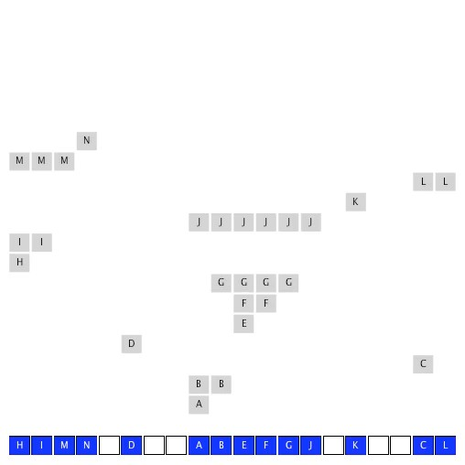



















Linear-probing symbol table: Java implementation
Linear-probing symbol table: Java implementation
30
public class LinearProbingHashST<Key, Value>
{
public class LinearProbingHashST<Key, Value>
{
private int M = 30001;
private Value[] vals = (Value[]) new Object[M]; private Key[] keys = (Key[]) new Object[M];
private int hash(Key key) { /* as before */ } private Value get(Key key) { /* previous slide */ }
}
private int M = 30001;
private Value[] vals = (Value[]) new Object[M];
array doubling and halving code omitted
private Key[] keys = (Key[]) new Object[M];
private int hash(Key key) { /* as before */ }
private void put(Key key, Value val) { /* next slide */ }
public Value get(Key key)
{
for (int i = hash(key); keys[i] != null; i = (i+1) % M) if (key.equals(keys[i]))
return vals[i]; return null;
}
public void put(Key key, Value val)
{
int i;
for (i = hash(key); keys[i] != null; i = (i+1) % M) if (keys[i].equals(key))
break; keys[i] = key; vals[i] = val;
}
}
29
Clustering
Cluster. A contiguous block of items.
Observation. New keys likely to hash into middle of big clusters.
Knuth's parking problem
Model. Cars arrive at one-way street with M parking spaces.
Each desires a random space i : if space i is taken, try i + 1, i + 2, etc.
Q. What is mean displacement of a car?
Half-full. With M / 2 cars, mean displacement is ~ 3 / 2. Full. With M cars, mean displacement is ~ π M / 8 .
displacement = 3
31
32

Slide 9
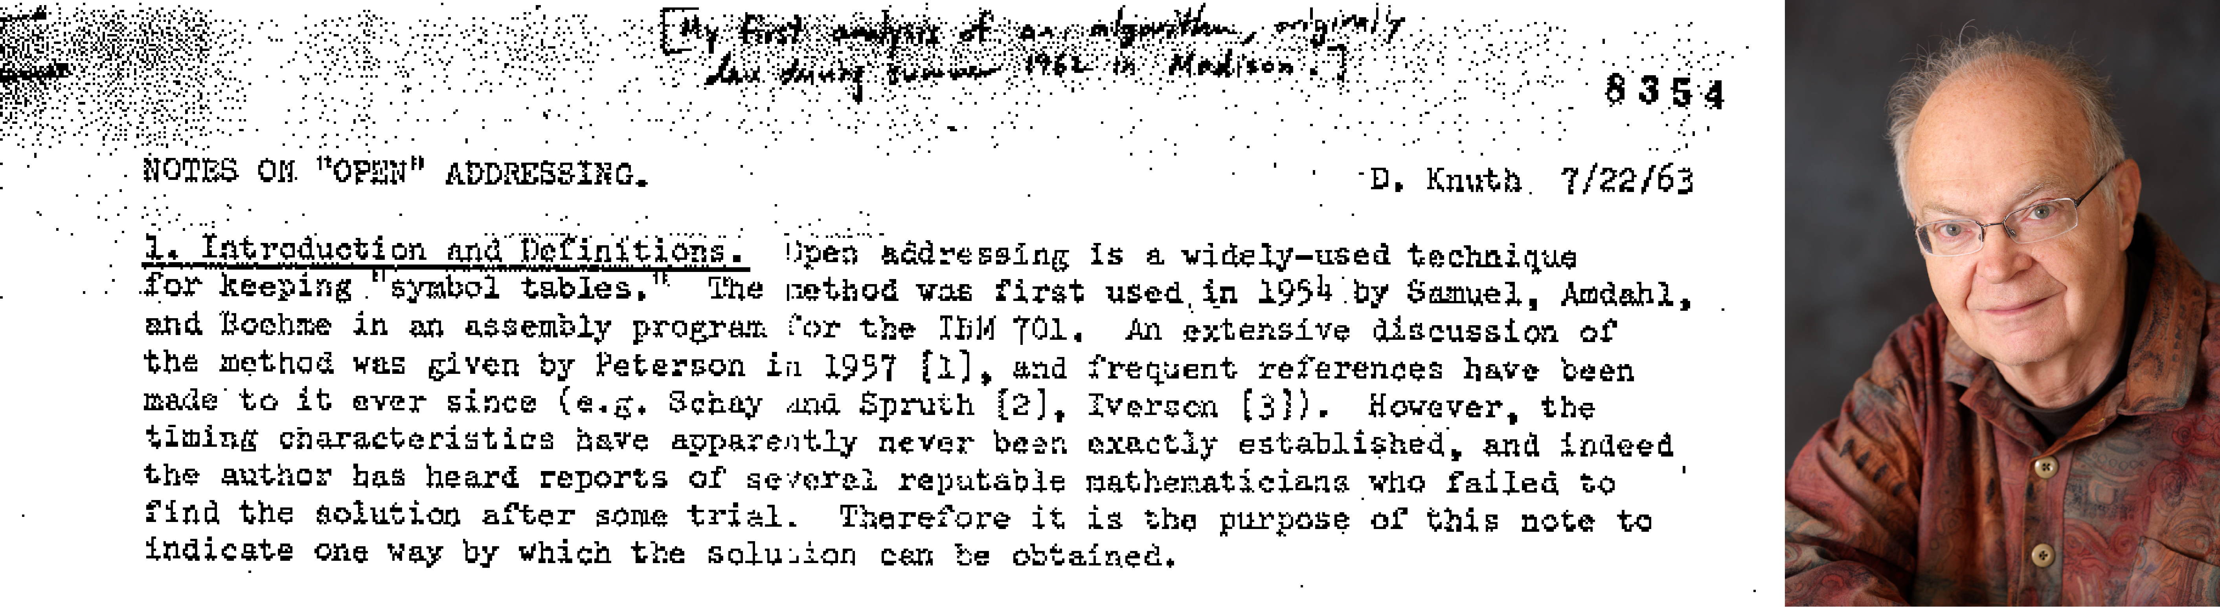
Analysis of linear probing
Resizing in a linear-probing hash table
Proposition. Under uniform hashing assumption, the average # of probes in a linear probing hash table of size M that contains N = α M keys is:
Goal. Average length of list N / M ≤ ½.
・Double size of array M when N / M ≥ ½.
・Halve size of array M when N / M ≤ ⅛.
1
1 1
1 - a
1 (1 - a)²
・Need to rehash all keys when resizing.
⇥ 1 +
⇥ 1 +
2
2
search hit
search miss / insert
Pf. | before resizing
 |  | 0 | 1 | 2 | 3 | 4 | 5 | 6 7
 | keys[] vals[] |  | E 1 | S 0 |  |  | R 3 | A 2
Parameters.
after resizing
・M too large ⇒ too many empty array entries.
search time blows up.
0
1
2
3
4
5
6
7
8
9
10 11 12 13 14 15
・M too small ⇒
keys[]
A
S
E
R
・Typical choice: α = N / M ~ ½.
# probes for search hit is about 3/2
# probes for search miss is about 5/2
vals[]
2
0
1
3
33
34
Deletion in a linear-probing hash table
ST implementations: summary
Q. How to delete a key (and its associated value)?
A. Requires some care: can't just delete array entries.
implementation | guarantee |  |  | average case |  |  | ordered ops? | key interface
 | search | insert | delete | search hit | insert | delete
sequential search (unordered list) | N | N | N | ½ N | N | ½ N |  | equals()
binary search (ordered array) | lg N | N | N | lg N | ½ N | ½ N | ✔ | compareTo()
BST | N | N | N | 1.39 lg N | 1.39 lg N | √ N | ✔ | compareTo()
red-black BST | 2 lg N | 2 lg N | 2 lg N | 1.0 lg N | 1.0 lg N | 1.0 lg N | ✔ | compareTo()
separate chaining | N | N | N | 3-5 * | 3-5 * | 3-5 * |  | equals() hashCode()
linear probing | N | N | N | 3-5 * | 3-5 * | 3-5 * |  | equals() hashCode()
before deleting S
0
1
2
3
4
5
6
7
8
9
10 11 12 13 14 15
keys[]
P M
A C S H L
E
R X
vals[]
10 9
8 4 0 5 11
12
3 7
after deleting S ?
doesn't work, e.g., if hash(H) = 4
 | 0 | 1 | 2 | 3 | 4 | 5 | 6 | 7 | 8 | 9 | 10 | 11 | 12 | 13 | 14 | 15
keys[] | P | M |  |  | A | C |  | H | L |  | E |  |  |  | R | X
vals[] | 10 | 9 |  |  | 8 | 4 |  | 5 | 11 |  | 12 |  |  |  | 3 | 7
35
* under uniform hashing assumption
36

Slide 10


War story: algorithmic complexity attacks
Q. Is the uniform hashing assumption important in practice?
A. Obvious situations: aircraft control, nuclear reactor, pacemaker.
A. Surprising situations: denial-of-service attacks.
3.4 HASH TABLES
st[]
0
hash functions
separate chaining
linear probing
context
1
2
3
4
5
6
7
malicious adversary learns your hash function (e.g., by reading Java API) and causes a big pile-up in single slot that grinds performance to a halt
Algorithms
Real-world exploits. [Crosby-Wallach 2003]
ROBERT SEDGEWICK | KEVIN WAYNE
・Bro server: send carefully chosen packets to DOS the server, using less bandwidth than a dial-up modem.
http://algs4.cs.princeton.edu
・Perl 5.8.0: insert carefully chosen strings into associative array.
・Linux 2.4.20 kernel: save files with carefully chosen names.
38
War story: algorithmic complexity attacks
Algorithmic complexity attack on Java
A Java bug report.
Goal. Find family of strings with the same hash code. Solution. The base-31 hash code is part of Java's string API.
Jan Lieskovsky 2011-11-01 10:13:47 EDT Description
Julian Wälde and Alexander Klink reported that the String.hashCode() hash function is not sufficiently collision resistant. hashCode() value is used in the implementations of HashMap and Hashtable classes:
http://docs.oracle.com/javase/6/docs/api/java/util/HashMap.html http://docs.oracle.com/javase/6/docs/api/java/util/Hashtable.html
A specially-crafted set of keys could trigger hash function collisions, which can degrade performance of HashMap or Hashtable by changing hash table operations complexity from an expected/average O(1) to the worst case O(n). Reporters were able to find colliding strings efficiently using equivalent substrings and meet in the middle techniques.
This problem can be used to start a denial of service attack against Java applications that use untrusted inputs as HashMap or Hashtable keys. An example of such application is web application server (such as tomcat, see bug #750521) that may fill hash tables with data from HTTP request (such as GET or POST parameters). A remote attack could use that to make JVM use excessive amount of CPU time by sending a POST request with large amount of parameters which hash to the same value.
This problem is similar to the issue that was previously reported for and fixed in e.g. perl:
http://www.cs.rice.edu/~scrosby/hash/CrosbyWallach_UsenixSec2003.pdf
key | hashCode()
"Aa" | 2112
"BB" | 2112
key | hashCode()
"AaAaAaAa" | -540425984
"AaAaAaBB" | -540425984
"AaAaBBAa" | -540425984
"AaAaBBBB" | -540425984
"AaBBAaAa" | -540425984
"AaBBAaBB" | -540425984
"AaBBBBAa" | -540425984
"AaBBBBBB" | -540425984
key | hashCode()
"BBAaAaAa" | -540425984
"BBAaAaBB" | -540425984
"BBAaBBAa" | -540425984
"BBAaBBBB" | -540425984
"BBBBAaAa" | -540425984
"BBBBAaBB" | -540425984
"BBBBBBAa" | -540425984
"BBBBBBBB" | -540425984
2^{N} strings of length 2N that hash to same value!
39
40

Slide 11
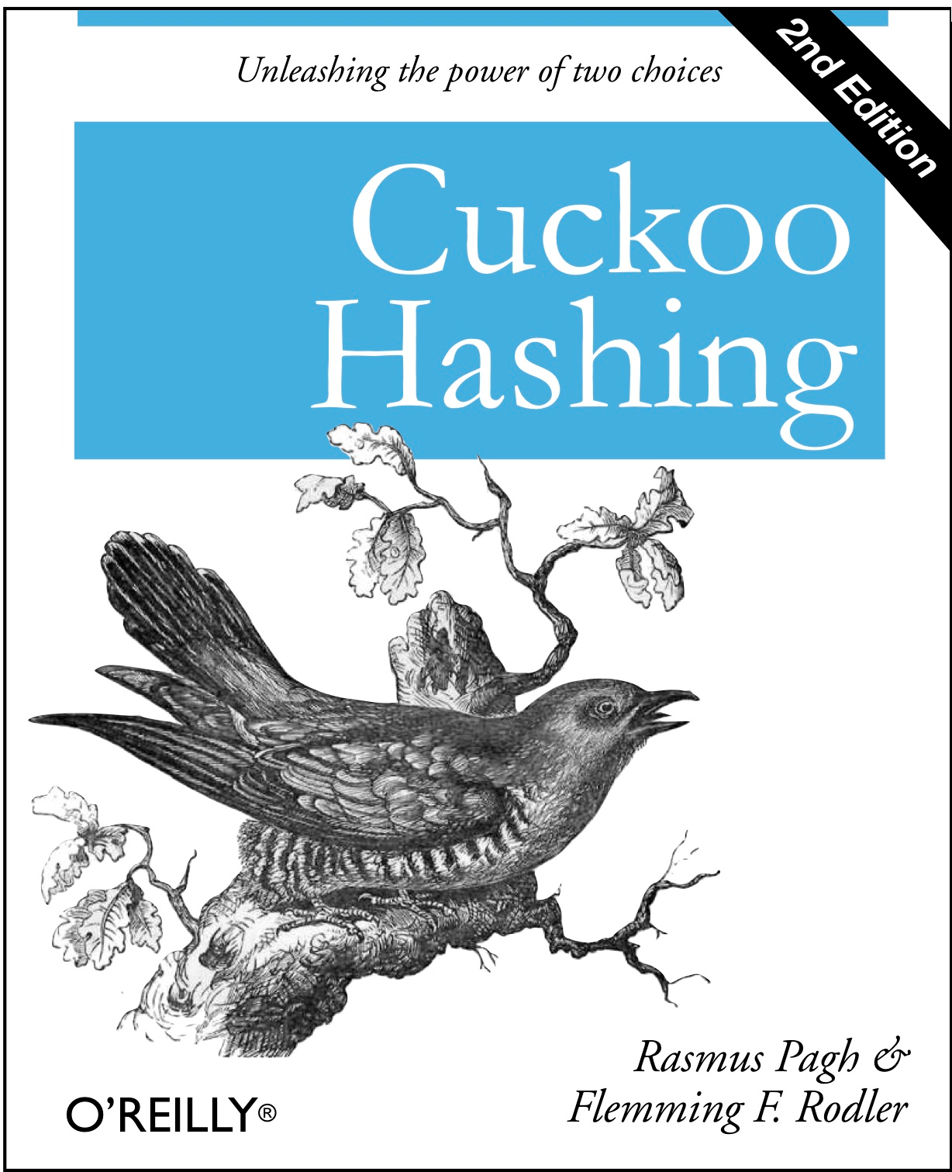
Diversion: one-way hash functions
Separate chaining vs. linear probing
One-way hash function. "Hard" to find a key that will hash to a desired value (or two keys that hash to same value).
Separate chaining.
・Performance degrades gracefully.
・Clustering less sensitive to poorly-designed hash function.
Ex. MD4, MD5, SHA-0, SHA-1, SHA-2, WHIRLPOOL, RIPEMD-160, ….
known to be insecure
Linear probing.
・Less wasted space.
A
8
E
12
・Better cache performance.
String password = args[0];
MessageDigest sha1 = MessageDigest.getInstance("SHA1"); byte[] bytes = sha1.digest(password);
/* prints bytes as hex string */
0
1
2
3
4
st[]
null
X
7
S
0
L
11
P
10
M
9
H
5
C
4
R
3
Applications. Digital fingerprint, message digest, storing passwords. Caveat. Too expensive for use in ST implementations.
0
1
2
3
4
5
6
7
8
9 10 11 12 13 14 15
keys[]
vals[]
P | M |  |  | A | C | S | H | L |  | E |  |  |  | R | X
10 | 9 |  |  | 8 | 4 | 0 | 5 | 11 |  | 12 |  |  |  | 3 | 7
41
42
Hashing: variations on the theme
Hash tables vs. balanced search trees
Many improved versions have been studied.
Hash tables.
・Simpler to code.
Two-probe hashing. [ separate-chaining variant ]
・No effective alternative for unordered keys.
・Hash to two positions, insert key in shorter of the two chains.
・Faster for simple keys (a few arithmetic ops versus log N compares).
・Reduces expected length of the longest chain to log log N.
・Better system support in Java for strings (e.g., cached hash code).
Double hashing. [ linear-probing variant ]
Balanced search trees.
・Use linear probing, but skip a variable amount, not just 1 each time.
・Stronger performance guarantee.
・Effectively eliminates clustering.
・Support for ordered ST operations.
・Can allow table to become nearly full.
・Easier to implement compareTo() correctly than equals() and hashCode().
Java system includes both.
・More difficult to implement delete.
Cuckoo hashing. [ linear-probing variant ]
・Red-black BSTs: java.util.TreeMap, java.util.TreeSet.
・Hash key to two positions; insert key into either position; if occupied, reinsert displaced key into its alternative position (and recur).
・Hash tables: java.util.HashMap, java.util.IdentityHashMap.
・Constant worst-case time for search.
43
44

